Slide 2
Portfolio Strategy
Ignite World Wide Tour
Microsoft Corporation

Slide 3
Agenda
Introduction Portfolio Management
Business Drivers
Overview
Explanation
Demonstration
Portfolio Analyses
Overview
Explanation
Demonstration

Slide 4
Introduction

Slide 5
Why is Effective Portfolio Management Important?
Portfolio Management
Enables organizations to identify and select the investments that will maximize business value
50% Value Lost
Portfolio
Management
Ability to identify business value potential
Project Management
Helps ensure organizations successfully deliver the selected investments and realize the business value
66%
50% Value Realized
Project
Management
75%
Ability to realize business value potential

Slide 6
Portfolio Management Processes
Common Challenges for “non existing” Portfolio Management processes
Unclear or missing strategic objectives
Prioritization of strategic objectives is subjective or non-existent
Project selection based on loose or inconsistent “methodologies”
Portfolio execution done prematurely
Benefits of Portfolio Management
Define and more objectively prioritize business strategy
Methodically evaluate and prioritize competing investments (projects)
Optimize budget and align selected investments with the business strategy
Plan for resource demand across portfolio before execution
Communicate selection decisions to stakeholders

Slide 7
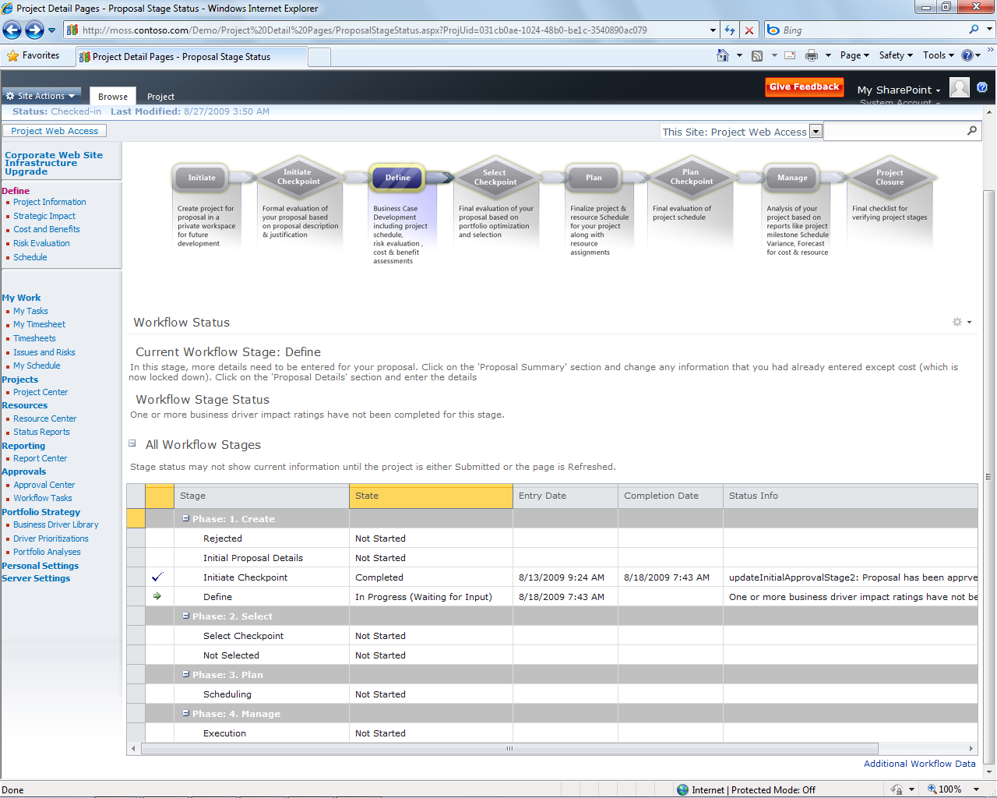
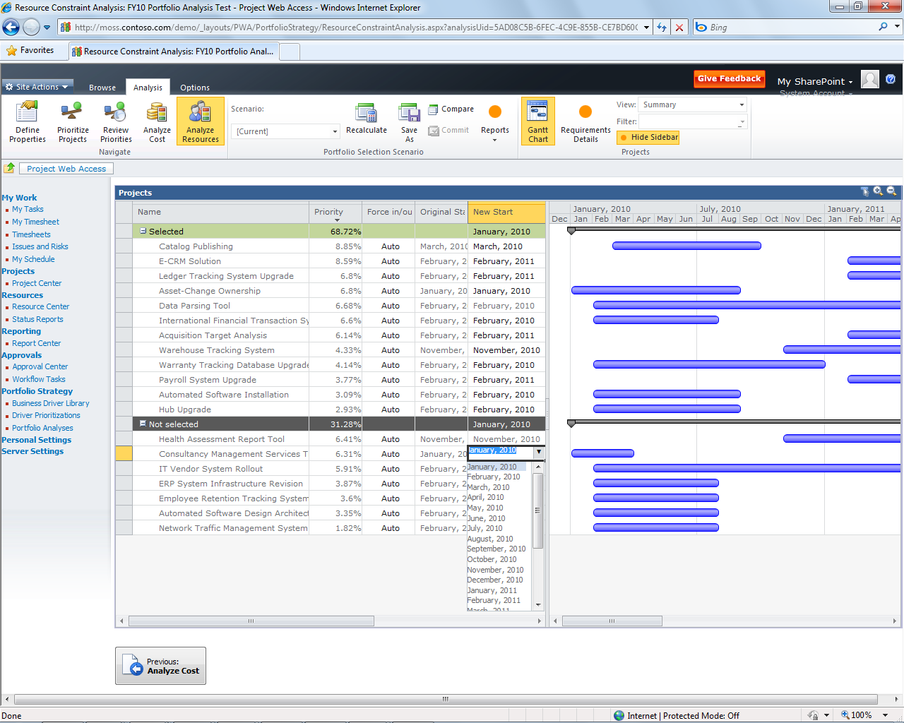
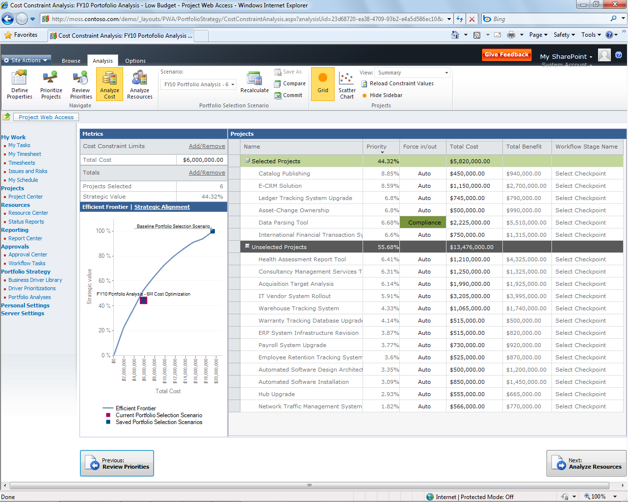

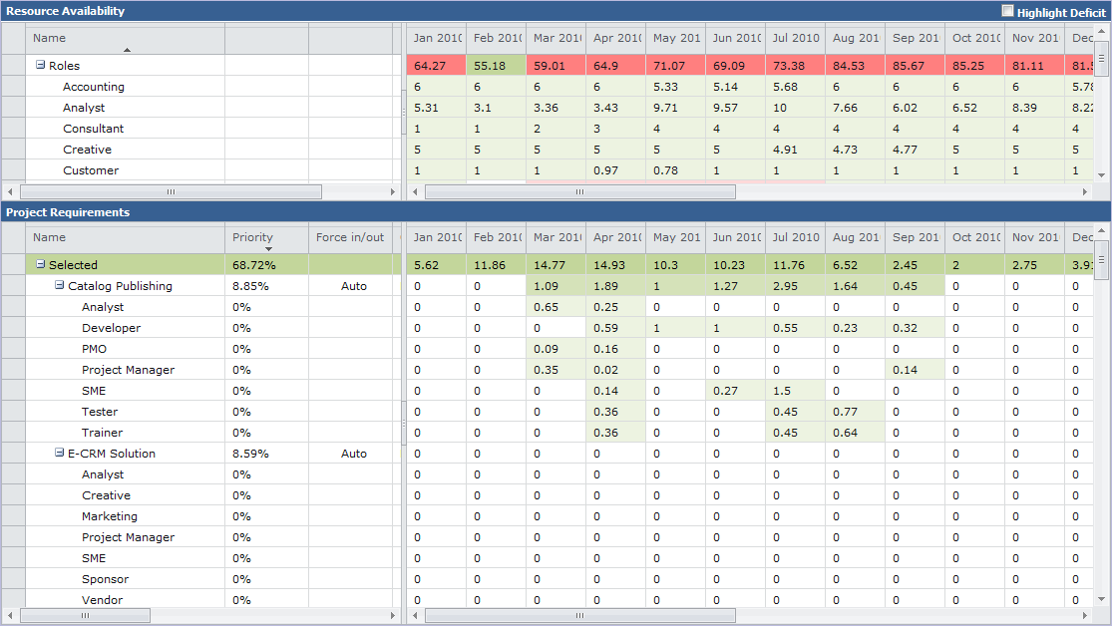


Unified Project and Portfolio Management Key benefits of Project Server 2010
Common streamlined user interface
Shared platform/architecture
Leverages scalable queue architecture
All data available via read/write Project Server Interface (PSI)
Final selection decisions published to Reporting Database (RDB)
No gateway required
New Resource Analysis
Unified Project and Portfolio Management
Enhanced Collaboration and Reporting
Scalable and Connected Platform
Simple and Intuitive User Experience

Slide 8
Unified Project and Portfolio Management Process in Project 2010
Helps organizations manage portfolios through their initial high-level prioritization processes
Project 2010 enables Portfolio Analysis
Create and prioritize business drivers
Establish project impacts on business drivers
Create and analyze project portfolios – save analyses and scenarios
Commit selected scenarios
Notes:
PWA = Project Web Access

Slide 9
Unified Project and Portfolio Management Further considerations
Three data points feed into the portfolio analysis process:
Cost (Number Custom Field) – e.g. Proposal Cost
Proposal/project impact on business drivers
Departments are supported to “filter” related Business Drivers
Time-phased resource requirements
Proposal will need a Resource Plan or Project Plan

Slide 10
Process Overview
Business Drivers Definition
Business Drivers Prioritization
Aligning Projects/Proposals to Business Drivers
Projects/Proposals Prioritization
Portfolio Analysis (cost, resource)

Slide 11
Deprecations
Financial Management
Customization: Simple estimation, tracking and forecasting of costs using Custom Fields
Partner Solution: UMT Cost Module
Benefits Estimation
Customization: Simple multi-year benefits captured using Custom Fields
Application Portfolio Management
Customization: Simple APM using EPTs and Custom Views
Partner Solutions: UMT APM Add-on Module

Slide 12
Deprecations Cont.
User Defined/Graphical Workflow
Customization: Workflow Visualization WebPart Solution Starter
Programs (Initiation and Selection Only)
Customization: PDP Infrastructure; Solution Starter
Surveys (Risk, Architectural Fit)
Customization: InfoPath Survey WebPart

Slide 13
Deprecations Cont.
Snapshot Reporting
Customization: Application to pull data from reporting db and push to a “trending” db daily
Audit History
Customization: Extend Workflow to track changes and report on it.
Change Requests
Customization: Solution Starter

Slide 14
Become a UMT Product Distribution and Solutions (PDS) Provider to enterprise customers worldwide
PDS program relies on the sales, technical and service expertise of our qualified partners to satisfy a wide range of customer needs world wide.
The products:
Project Financial Server (PFS) 2010 - Extends Project Server 2010 capabilities to support project and portfolio financial management and governance.
Application Portfolio Management (APM) Server2010 - Full APM capabilities including application inventory, resource, cost management, and application portfolio analysis.
Technology: Fully and seamless integration between PS2010, PFS 2010 and APM 2010
Pricing: Will be available as Server & CAL licensed products
The opportunity:
Distribute UMT products to your customer base
Provide solutions based on the UMT products
Extend UMT products
UMT’s PDS Benefits
Commisions
Sales and marketing readiness programs
Implementation readiness programs
Partnership Network - Mike Gruia, mgruia@umt.com, +1.917.572.4167
Product Knowledge - Ava Dadabhoy, adadabhoy@umt.com, +1.212.965.0550
Contact Information
Partnership Network
Mike Gruia
mgruia@umt.com
917.572.4167
Product Knowledge
Ava Dadabhoy
adadabhoy@umt.com
212.965.0550
Notes:
The UMT product distribution and solution provider (PDS) program assists solution providers who provide quality UMT solutions build on top of Microsoft Project server to customers worldwide.
UMT’s PDS program is restricted to a limited number of solution providers who have consistently demonstrated the ability to provide high quality, Microsoft Project-based solutions and services to enterprise customers worldwide.
The opportunity:
Distribute UMT products to your customer base
Provide solutions based on the UMT products
Extend UMT products
UMT’s PDS Benefits
Revenue sharing opportunities
Sales and marketing readiness programs: collateral, events, exclusive UMT technology briefings, referrals
Implementation readiness programs including UMT certified partner program

Slide 15
Business Drivers

Slide 16
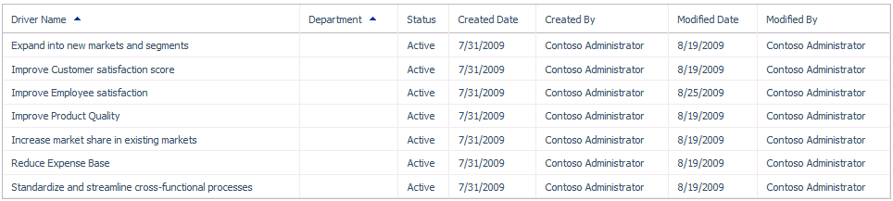
Business Driver
Business Drivers represent an organization’s business objectives in Project Server 2010
Create drivers in the Business Driver Library
May be associated with zero or more Departments
Drivers are prioritized to reflect organization’s perceived business impact and importance
Notes:
Business Drivers not associated with any Department is considered a global driver. When rating a project’s impact on a set of drivers, only drivers that share the same department of the project and all global drivers will be available and/or required for impact ratings. If the project does not have a departmental association, only global drivers will be available for rating.
When a business driver is no longer part of the currently organizational strategy, the driver should either be deleted or inactivated. Choose to inactivate a driver if you no longer want projects to be rated against this driver, but you would like to keep it for historical purposes.

Slide 17
Portfolio Strategy Requires a Clear Definition of Business Drivers –Examples
Expand into new markets and segments
Improve Customer Satisfaction Score
Improve Employee Satisfaction
Reduce Expense Base
Increase Market Share in Existing Markets

Slide 18
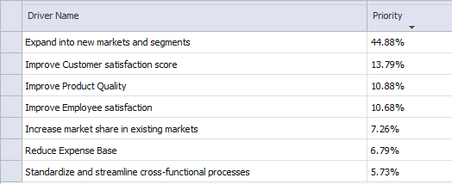
Driver Prioritization
As Business Drivers are defined, they need to be prioritized
Portfolio Strategy -> Driver Prioritization
Each driver prioritization can be “filtered ” by one department, or be left without

Slide 19
Driver Prioritizations
Two ways to prioritize business drivers:
Calculated: Each driver will be compared to every other driver within the prioritization using a fixed seven-point scale. Once every driver has been rated the system will automatically generate relative priority scores
Manual: Manual prioritizations allow users to specify priority values for each driver directly
Notes:
When creating new driver prioritizations, the prioritization’s department selection will filter the list of available drivers to be prioritized by department. Global drivers will be available regardless of the prioritization’s department. If a department is assigned to a prioritization, only drivers that share that departmental association can be included in the prioritization.

Slide 20
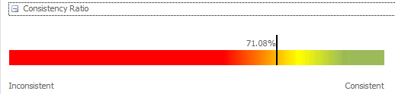
Calculated Driver Prioritization
System calculates the consistency ratio
Inconsistent prioritizations may make sense in some instances but should be reviewed carefully

Slide 21
Calculated Driver Prioritization Algorithm
Fill the systemic matrix with the pairwise values
Calculate eigenvector for the matrix
Normalize eigenvector values to 100% to derive relative priorities
 | Driver A | Driver B | Driver C | Driver D
Driver A | 1 | 9 | 6 | 1
Driver B | 1/9 | 1 | 3 | 1/6
Driver C | 1/6 | 1/3 | 1 | 1/3
Driver D | 1 | 6 | 3 | 1
 | Driver A | Driver B | Driver C | Driver D
Driver A |  | 9 | 6 | 1
Driver B |  |  | 3 | 1/6
Driver C |  |  |  | 1/3
Driver D
 | Driver A | Driver B | Driver C | Driver D
Driver A |  | Extremely More | Strongly More | Equal
Driver B |  |  | Moderately More | Strongly Less
Driver C |  |  |  | Moderately Less
Driver D
 | Driver A | Driver B | Driver C | Driver D
Driver A | 1 | 9 | 6 | 1
Driver B |  | 1 | 3 | 1/6
Driver C |  |  | 1 | 1/3
Driver D |  |  |  | 1

Slide 22
<Business Drivers Demo>
Walk through UI Portfolio Strategy
Create a new business driver
Use departments
Show driver library
Define project impact statements
Prioritize the drivers
Manual prioritization vs. calculated (pair wise comparison) prioritization,
Describe importance of consistency ratio

Slide 23
DEMO
Business Drivers

Slide 24
Portfolio Analyses

Slide 25




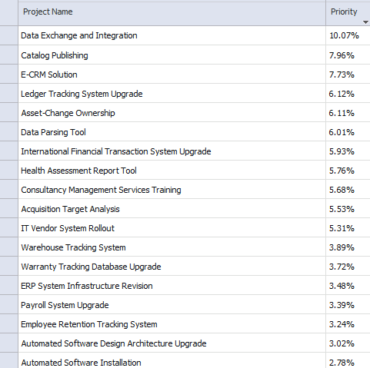
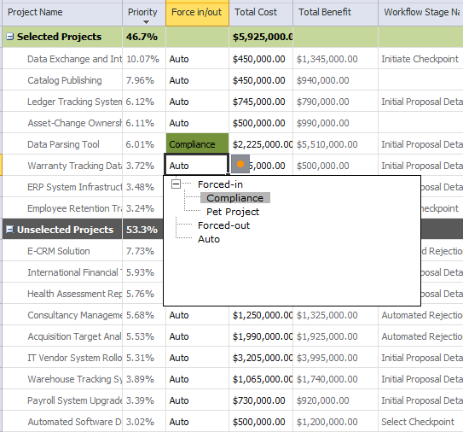
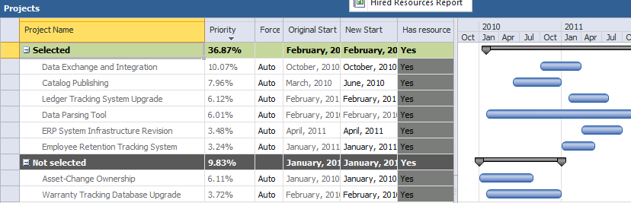
Portfolio Analyses
Portfolio analyses are a collection of projects that will compete for selection based on their cost relative to their strategic value
Prioritization of Projects:
By Business Drivers
By Custom Field

Slide 26
Aligning proposals/projects to Business Drivers
Defines impact of each proposal/project to individual Business Driver
Could be done within the Demand Management phase using specific “Project Detail Page”
Or right before running Portfolio Analysis

Slide 27

Some Questions Portfolio Analytics Helps to Answer
Are we investing in the right initiatives based on the company business priorities?
Which investments will produce an optimized portfolio of project?
Where are we willing to forgo strategic alignment?
What are the consequences of changes in strategic direction?
What are the implications of budget cuts or increases?

Slide 28
Project Prioritization Algorithm #1 (using business drivers impact statements)
Fill the impact matrix with the numeric values
Multiply matrix with driver priorities
Normalize resulting absolute values to 100% to derive relative priorities
 | Driver A | Driver B | Driver C | Driver D
Project 1 | 0 | 3 | 1 | 9
Project 2 | 9 | 1 | 1 | 0
Project 3 | 1 | 3 | 0 | 3
Project 4 | 0 | 1 | 0 | 1
Project 5 | 1 | 6 | 0 | 0
Project priorities
P1: 20%
P2: 42%
P3: 15%
P4: 4%
P5: 19%
 | Driver A | Driver B | Driver C | Driver D
Project 1 | None | Moderate | Low | Extreme
Project 2 | Extreme | Low | Low | None
Project 3 | Low | Moderate | None | Moderate
Project 4 | None | Low | None | Low
Project 5 | Low | Strong | None | None
Driver priorities
A: 41%
B: 25%
C: 22%
D: 12%
X
=

Slide 29
Project Prioritization Algorithm #2 (using custom fields)
SumOfAbsolutePriorities = 0
For each Project
AbsPriority = 0
For each KPI
AbsPriority+= NormalizedKPIValue * KPIWeight
SumOfAbsPriorities+= AbsPriority
For each Project
Priority= AbsPriority / SumofAbsPriorities
 | Immediate downtime (60%) | Future downtime (20%) | # of sites impacted (15%) | Usage at sites (5%) | Aggregated priorities | Relative priorities
Project 1 | Yes | No | 1 | Low | 69.92% | 54.41%
Project 2 | No | Yes | 28 | High | 27.88% | 21.69%
Project 3 | No | Yes | 5 | Moderate | 19.35% | 15.06%
Project 4 | No | No | 28 | High | 11.36% | 8.84%
 | Immediate downtime (60%) | Future downtime (20%) | # of sites impacted (15%) | Usage at sites (5%) | Aggregated priorities | Relative priorities
Project 1 | 1 | 0 | 1 | 20 | 69.92% | 54.41%
Project 2 | 0 | 1 | 28 | 60 | 27.88% | 21.69%
Project 3 | 0 | 1 | 5 | 40 | 19.35% | 15.06%
Project 4 | 0 | 0 | 28 | 60 | 11.36% | 8.84%

Slide 30
Force In/Out
A portfolio may contain projects that must be either selected or not selected, regardless of their cost/value ratio or their dependencies on other projects.
Aliases available for “Force In/Out” per analysis
Examples:
A non-strategic project that must be implemented because of legal compliance issues will need to be “forced in” the portfolio.
A very costly project might need to be “forced out” of a portfolio to free up resources for other projects and improve the portfolio’s overall ROI
Notes:
ROI = Return on Investment

Slide 31
Project Interdependencies
Project dependency relationship will be respected during portfolio selection scenario calculations
There are following types of interdependencies:
Dependency: If Project A selected, Project B must be selected
Mutual Inclusion: For a set of projects, if one project is selected, all projects in the set must be selected.
Mutual Exclusion: For a set of projects, only one project in the set can be selected (Alternatives).
Finish to Start: Used in Resource Constraint Analysis for identifying scheduling constrains

Slide 32
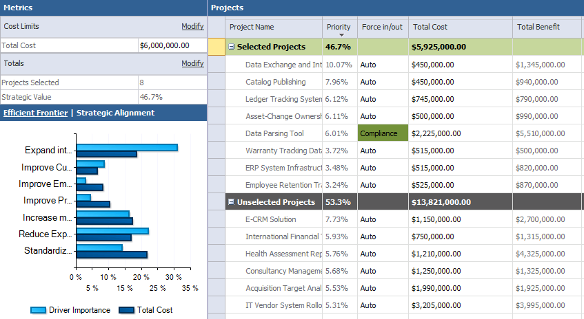
Cost Constraint Analysis
Initially a baseline project cost analysis is created automatically assuming all projects will be funded at their cost
Portfolio Manager (person) then sets cost constraints (likely lower than full funding)
Portfolio will present projects selected and unselected based on:
Project’s cost compared to value
Forced In and Forced Out projects

Slide 33
Constraint Optimization The need for optimization
Available budget: $100
Request: chose the projects that provide maximum value to the business
Top-down selection
Optimization
 | Value | Cost
Project 1 | 30% | $100
Project 2 | 20% | $60
Project 3 | 15% | $40
 | Value | Cost
Project 1 | 30% | $100
Project 2 | 20% | $60
Project 3 | 15% | $40
Total strategic value: 30%
Total strategic value: 35%

Slide 34
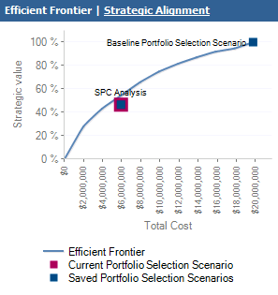
Constraint Optimization Algorithm
Maximize (x1*v1+x2*v2+x3*v3+ … +xn*vn)
Subject To:
x1*c1+x2*c2+x3*c3+ … +xn*cn <= C
Where
x1, x2… xn = 0 or 1 (algorithm outputs: project in/out)
v1, v2… vn are the project priorities
c1, c2… cn are the constraint values for each project
C is the total constraint value; we have one such row for each constraint
Efficient frontier (based on one constraint):
For N data points equally spaced between zero and the sum of the constraint
Run Optimization algorithm and determine corresponding portfolio value

Slide 35
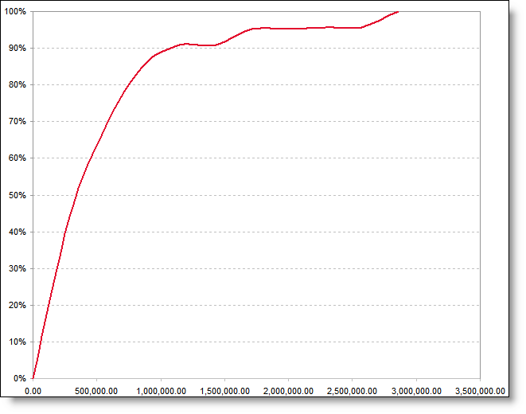
Value Against Investment Objectives - Example Analysis
What can an Efficient Frontier chart tell us - given a fixed budget, this process will suggest which projects/initiatives to fund
Portfolio Value Curve (Efficient Frontier)
20 projects
Diminishing Value
Example Conclusions:
85% of the Business Driver Alignment Value is Supported by Only 35% ($ xxxx M) of the Budget ($ yyyyy M)
2 “large projects” constituting 60% of the budget, contribute to only 20% of the portfolio’s value.
16 projects
Inflection Point
9 projects
Alignment
Value
Cost

Slide 36
Resource Constraint Analysis Related Portfolio Analysis Configuration
Specify the resource custom field that defines role
Specify the planning horizon dates and granularity
Filter resources by department or RBS value
Consider proposed bookings when calculating capacity for projects outside the analysis (advanced)
Specify how project dates are set
Respect the project resource plan setting which allows pulling resource requirement data from the project schedule, the resource plan, or a mixture of the two
Use project date custom fields to specify dates

Slide 37
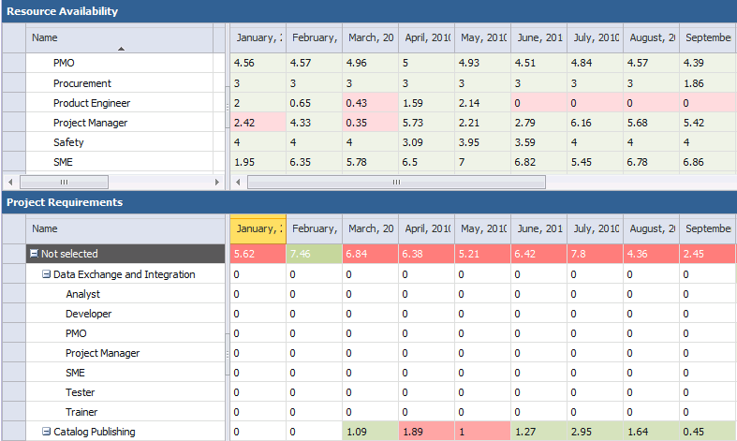
Resource Capacity Analysis Role based analysis

Slide 38
Resource Constraint Analysis Simplified Algorithm – Resource Allocation
Portfolios may also be analyzed by their high-level resource requirements combined with their prioritization
Higher priority projects are resourced first, lower priority projects are resourced last.
If resource availability does not meet a given project’s demand for any period for any role, that project is not resourced and the project with the next lowest priority is examined

Slide 39
Resource Capacity Analysis Algorithm – Resource Allocation (patented)
Sort projects by dependencies, force status and priorities (descending)
Eliminate projects that are dependent on forced-out ones (track feasibility)
Try to allocate resources to all projects left (track feasibility)
For each time frame in project life
For each requested role
If resources are not available
If internal hiring
Round up the required FTE
If dollars budget and internal hiring
then compute hiring cost to the end of planning horizon
else compute hiring for current time frame
If budget (dollars or FTE) exhausted
Fail allocation and bail out
If internal hiring
Roll internal role hires for the remaining time frames
else allocate requested resources

Slide 40
Proportional Solutions
Sometimes, you need to “spread the pain” of budget cuts rather then optimize based on maximum business value
important feature for public sector clients
Concept of proportional solutions could be used in Project 2010.
Perform an analysis of “programs”. Prioritize the programs, and proportionally distribute money based on priority (e.g. higher priority programs get more $; this would be done by doing the calculation outside the tool and writing the results to a custom field). The tool here is simply providing the prioritization mechanism that you can use to proportionally distribute funds using your own algorithm.
Then perform another analysis for each program’s sub projects using the budget for that program ascertained in step 1. Select support projects to that program based on the budgetary cost constraint in the Cost Analysis step (the Optimizer)
Or, you can change the project-level constraint values when doing Cost analysis using a formula that mimics proportional cuts.

Slide 41
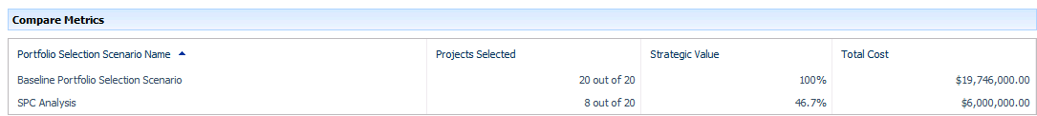
Portfolio Comparison
Portfolio selections scenarios should be adjusted and recalculated until a scenario is reached that should be finalized or compared with other scenarios
Portfolios may be compared with each other by:
Projects Selected
Strategic Value
Custom Fields (example: ROI )

Slide 42

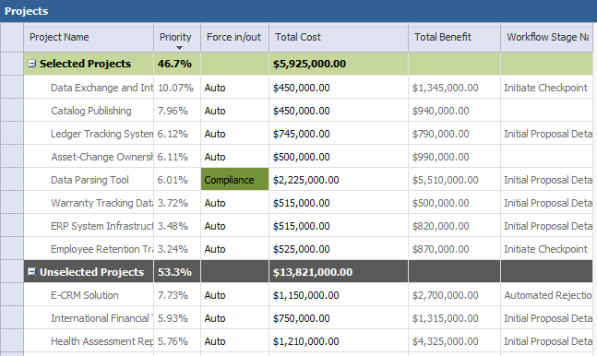
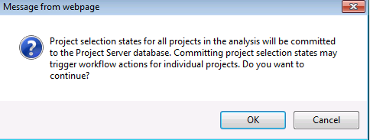
Commit Portfolio Analysis Decisions
Once you have completed your portfolio analysis, the final step is to commit your portfolio
Optionally, committed portfolios may kick off a workflow

Slide 43
<Portfolio Analysis and Decisions Demo>
Walk through the steps of portfolio analysis creation:
Use set of defined business drivers to analyze and prioritize portfolio
Show Force in/out, Project Interdependencies features
Introduce Cost Constrains and recalculate
Introduce Resource Constraints and recalculate -review two reports available OOB
Portfolio Comparison – commit chosen portfolio
(optional, time permitting ) Go back and run portfolio analysis again but this time based on a custom field

Slide 44
DEMO
Portfolio Analysis and Decisions

Slide 45
Partner Opportunities
Project Financials
Product Innovation
Application Portfolio Management
Asset Management
Capital Planning & Budgeting

Slide 46
Next Steps and Approach
There is a potential for getting more project initiatives better aligned with your business strategies and implemented within your budget through application of the portfolio analytics process:
Obtain Senior Management Sponsorship - they define business priorities
Schedule a facilitated “Envisioning Session” to validate your deployment plans and assumptions
Assign a project manager to spearhead the effort
Build a team
Set objectives
Develop a Vision & Scope Document and an Implementation Plan
Put contracts in place with necessary vendors, procure required skills
Constantly remind yourselves that the portfolio analytics process is “a process” and not a tool

Slide 47
Questions?

Slide 48

© 2009 Microsoft Corporation. All rights reserved. Microsoft, Windows, Windows Vista and other product names are or may be registered trademarks and/or trademarks in the U.S. and/or other countries.
The information herein is for informational purposes only and represents the current view of Microsoft Corporation as of the date of this presentation. Because Microsoft must respond to changing market conditions, it should not be interpreted to be a commitment on the part of Microsoft, and Microsoft cannot guarantee the accuracy of any information provided after the date of this presentation. MICROSOFT MAKES NO WARRANTIES, EXPRESS, IMPLIED OR STATUTORY, AS TO THE INFORMATION IN THIS PRESENTATION.

